Slide 1


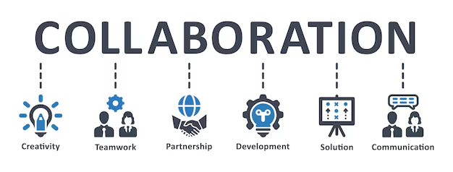
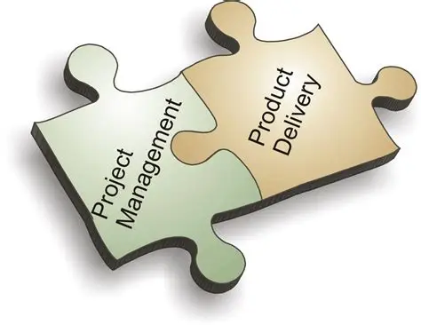
How we plan to meet needs
Understand needs - fit new innovations – engage & deliver
Optional Commonwealth and State Grants for the scale up of new innovations
1
Advice on fit for purpose innovative outcomes
Develop a consortium to scale up and implement new technologies
2
Select the Delivery Mode
of engagement and
collaborative service delivery. Validation of the innovation.
3
Deliver the outcomes
Use Key Performance based Validation
Commissioning and operationalisation of the innovations.
Project Management Engagement through Fit for Purpose Delivery Modes
Implementation through hybrid agreements funded by the industry

Slide 2

Touch points
Translation into –- Fit for Purpose
Innovative Solutions as Business as Usual – with capability to implement
Water Industry Partner
Innovation
(Existing)
Core Agreement between Client and Innovative Solutions
Innovative Water Services Solutions
Deployment
Company
Translation research outcome into deployable opportunity (Academics and Companies)
Validation (Academics and Partner)
Water Industry Partner

